Slide 1
.NET Telemetry in the Real World
Stephen Cleary
Notes:
Questions welcome!

Slide 2


Who is this guy?
Notes:
Christian, husband, father, developer

Slide 3


Slide 4
Telemetry

Slide 5
Telemetry Terminology
Open Telemetry (OTEL)
Open Telemetry Protocol (OTLP)
  gRPC:4317 / HTTP:4318

Slide 6
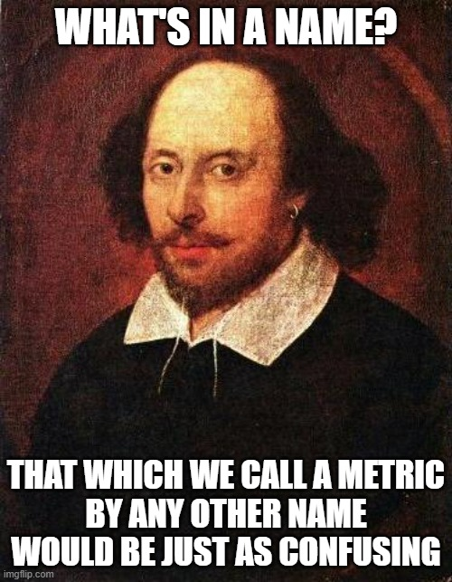
Telemetry Terminology
Logs
Metrics
  Measurements. Think Prometheus/Grafana dashboards.
Traces
  Spans. Think waterfall diagrams or Start/Stop events.
Timing is a grey area; prefer traces unless you need metric.

Slide 7
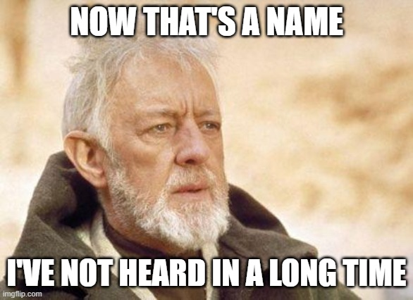
Telemetry History: Metrics
In the beginning, there were PerformanceCounters
PerformanceCounters were replaced by EventCounters
EventCounters are now replaced by OTEL Metrics

Slide 8
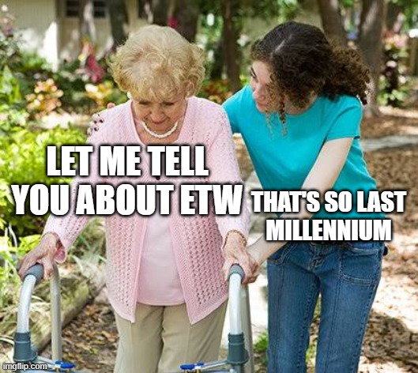
Telemetry History: Traces
ETW (Event Tracing for Windows) – extremely high-performance instrumentation across drivers et. al.
Not particularly easy to use from C#
Custom
TraceSource
Modern: OTEL Traces
  Replaces all of these.
Notes:
TraceSource: TraceEventType had Error/Warning/Information, but also Start and Stop

Slide 9
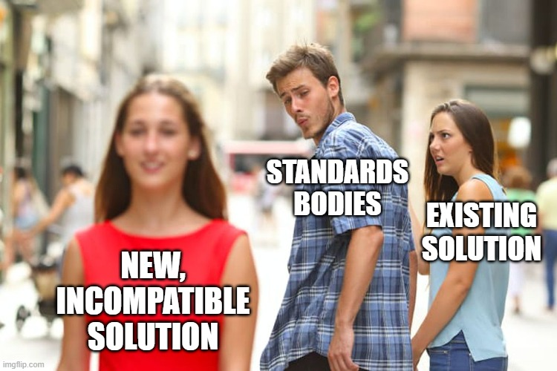
Telemetry History: Logs
ETW logs
Custom logs
EventLog (particularly services)
Trace.WriteLine – replaced by TraceSource
TraceSource
Modern: OTEL logs
  Replaces all of these

Slide 10
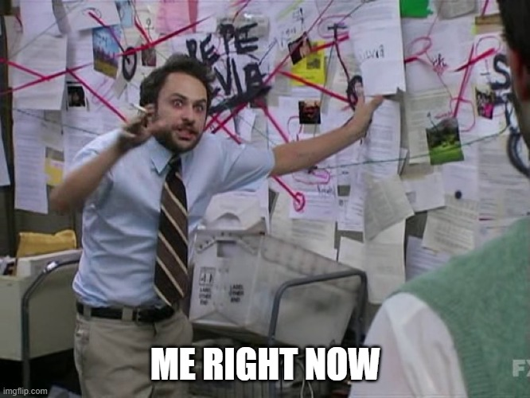

Demo: Local Telemetry
https://github.com/StephenCleary/LocalTelemetry
Seq
OTLP endpoint
OTEL Collector
Aspire
Zipkin
Prometheus
Grafana
Jaeger
Honeycomb

Slide 11
Demo 1: Telemetry the Easy Way
Notes:
(and under the hood of Aspire)
(and example of failures)
(compare how Seq combines logs and traces, while Aspire separates them)
(undo failure code before continuing)
(enable MySqlConnector)

Slide 12
Semantic Logging

Slide 13
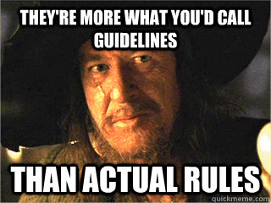
Semantic logging
A.k.a. Structured logging
A.k.a. Message templates https://messagetemplates.org/
Technically violates 12-factor app: https://12factor.net/

Slide 14
Semantic Logging: Getting a logger
Modern dependency injection
  Configure your logger with its backend output(s).
  Inject ILogger<T>
  Note: if you need to dynamically create loggers, inject ILoggerFactory, not ILoggerProvider.
    ILoggerFactory is for getting loggers for your components to use.
    ILoggerProvider is for implementing custom backend outputs.
  Tip: ILogger<T> is covariant; you can pass it to base types!
Everything else:
  Configure a logger factory via LoggerFactory.Create
  Call CreateLogger on the factory.

Slide 15
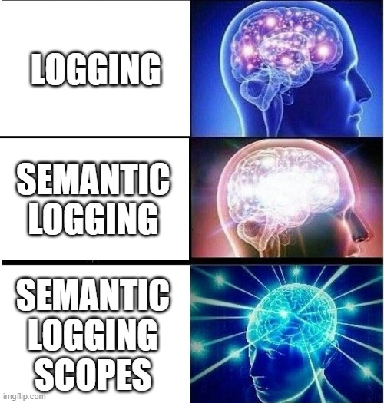
Semantic Logging: Basic Logging
Log with placeholders, like this:
_logger.LogInformation("Forecast result: {temperature}", temperatureValue);
This is not string interpolation!
This is not format string arguments!
This is a message template.
What actually happens (mostly):
{ message: "Forecast result: 13", temperature: 13 }

Slide 16
Demo 2: Basic Semantic Logging
Notes:
And searching by tags

Slide 17
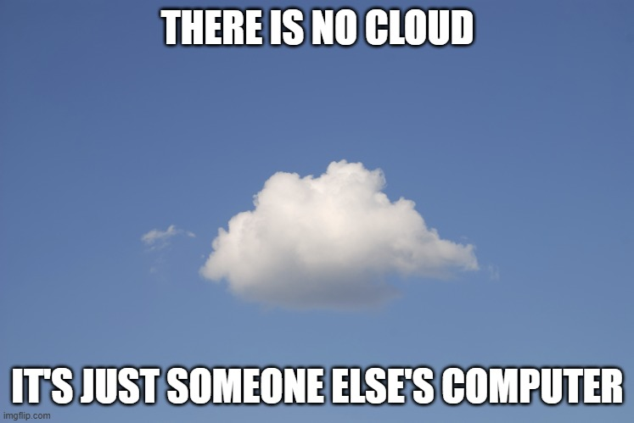
Semantic Logging: Backend options
Cloud:
  Azure Monitor https://tinyurl.com/WillAzureMonitorSupportOTLP
    toint(customDimensions[“temperature"]) > 5
  AWS CloudWatch (https://tinyurl.com/AWS-OTEL-logs)
    temperature > 5 { $.temperature > 5 }
SaaS:
  Honeycomb
  Graylog cloud
  Papertrail
Self-hosted: Graylog, Seq

Slide 18
Semantic Logging: Performance
Basic form:
_logger.LogInformation("Forecast result: {temperature}", temperature);
Performant form:
_logger.LogTemperature(temperature);
[LoggerMessage(Level = LogLevel.Information, Message = "Forecast result: {temperature}")]
static partial void LogTemperature(this ILogger logger, int temperature);
Notes:
(I don’t bother; this is really for hot path or framework/library code)

Slide 19
Semantic Logging: Scopes!
This is your hero superpower.
Scopes allow you to attach name:value data pairs to all logs within a scope.
Notes:
I don’t want to add “User” to every single log statement!

Slide 20
Demo 3: Scopes

Slide 21
Semantic Logging Scopes
The scope type is
IEnumerable<KeyValuePair<string, object>>
  https://tinyurl.com/BeginScope
Tip: helpers are convenient. E.g., https://github.com/stephenCleary/Logging

Slide 22
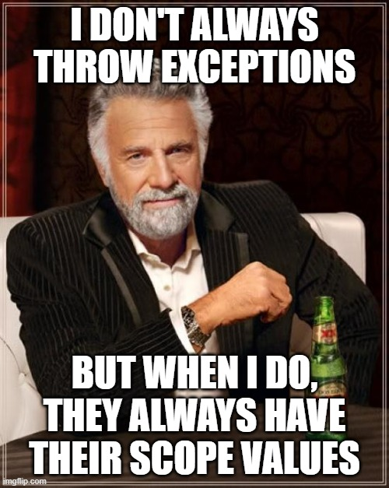
Semantic Logging Scopes
Common pitfall: exception handling scopes.
  The scopes in force when the exception is thrown are different than when the exception is logged.
Workaround:
  Capture the scopes when the exception is thrown.
  Restore the scopes when the exception is logged.
  https://github.com/stephenCleary/Logging
Alternative: Seq has a “throw context enricher”.
Notes:
“throw context enricher”: we wrote our own for log4net

Slide 23
Demo 4: Scopes in the Real World
Notes:
Including custom logger implementation.

Slide 24
Metrics

Slide 25
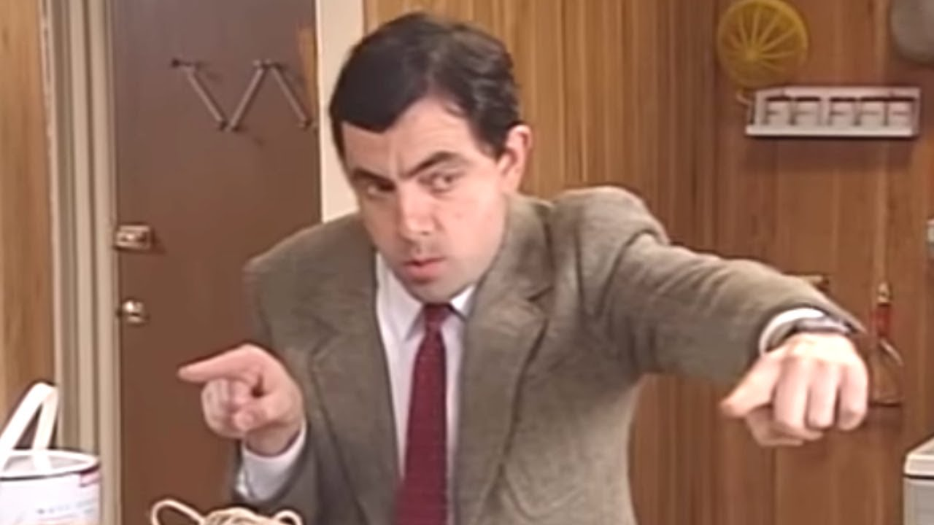
Metrics: Things to measure
Most metrics are counters (Counter or UpDownCounter)
Gauge (when sums don’t make sense, e.g., percentages)
Histogram (distributions only)

Slide 26
Demo 5: Custom Counter Metric
Notes:
Personally, I don’t find custom metrics to be particularly valuable.

Slide 27

Metrics: A word of warning
Metrics have dimensions.
  Must be a fixed (and small) number of values!
  Stored as one metric per unique set of values across all dimensions
  This gets expensive, fast!
  Cardinality:
    Hat sales: 3 sizes, 5 colors = 15
  Use tags instead, if possible.

Slide 28
Traces

Slide 29
Traces == Activities == Spans
Traces also support tags.
They can be completed successfully or with error.
They also have “events” which can happen within the trace, e.g., exceptions.

Slide 30
Demo 6: Custom Traces

Slide 31
Distributed Traces
Kind: Internal, Client, Server
Mostly automatic if you’re on .NET Core (ASP.NET Core + HttpClient).
Library support varies; MySqlConnector is great, SQLite needed help.

Slide 32
Demo 7: Distributed Traces

Slide 33
Asynchronous Distributed Traces
Kind: Internal, Client, Server, Producer, Consumer
Currently: no automatic support (although libraries like RabbitMQ .NET Client could make it automatic).
Propagation API is odd because it can be used with: HTTP headers, queue message metadata, arbitrary dictionaries.
  E.g., child process using serialized JSON.

Slide 34
Demo 8: Asynchronous Distributed Traces

Slide 35

Q&A
Go forth and be awesome!
Image from Etsy user Rosewine; used with permission

Slide 36
Distributed tracing (including across queues):
  https://tinyurl.com/OTEL-RabbitMQ
Pitfall:
  Know your backend (e.g., Graylog’s ElasticSearch index typing)

